Slide 1
Before we talk about Nondeterminism
What is Determinism?
Every step of a computation follows in a unique way from the preceding step.
When the machine is in a given state and reads the next input symbol, we know what the next state will be — it is determined.
No choices
No randomness
No oracles
No cheating
DFA tells exactly to each state to go next
Perfect repeatability
No need any “magic” to know the choice to make
No errors or malfunctions

Slide 2
Nondeterminism
Several choices may exist for the next state at any point.
Nondeterminism is a generalization of determinism.
Every DFA is automatically a Nondeterministic Finite Automaton (NFA).
Several choices
𝑁₁
alphabet or ε
𝑎
𝑎
𝑏
𝑎, 𝜀𝜀
𝑞₁
𝑞₂
𝑞₃
𝑞₄
𝑏

Slide 3
Nondeterminism
Several choices may exist for the next state at any point.
Nondeterminism is a generalization of determinism.
Every DFA is automatically a Nondeterministic Finite Automaton (NFA).
𝑁₁
New features of nondeterminism:
- multiple paths possible (0, 1 or many)
𝑎
𝑎
𝑏
𝑎, 𝜀𝜀
ε-transition is a “free” move without reading input
string input accepted if some path leads to accept state
𝑞₁
𝑞₂
𝑞₃
𝑞₄
𝑏

Slide 4

Nondeterminism
Several choices may exist for the next state at any point.
Nondeterminism is a generalization of determinism.
Every DFA is automatically a Nondeterministic Finite Automaton (NFA).
𝑁₁
Input Example:
𝑎
𝑎
Input: 𝑎𝑏
𝑏
𝑎, 𝜀𝜀
𝑞₁
𝑞₂
𝑞₃
𝑞₄
𝑏

Slide 5
Nondeterminism
Several choices may exist for the next state at any point.
Nondeterminism is a generalization of determinism.
Every DFA is automatically a Nondeterministic Finite Automaton (NFA).
𝑁₁
Input Example:
𝑎
𝑎
Input: 𝑎𝑏
𝑏
𝑎, 𝜀𝜀
𝑞₁
𝑞₂
𝑞₃
𝑞₄
Start in state 𝑞₁
𝑏

Slide 6
Nondeterminism
Several choices may exist for the next state at any point.
Nondeterminism is a generalization of determinism.
Every DFA is automatically a Nondeterministic Finite Automaton (NFA).
𝑁₁
Input Example:
Read 𝑎
𝑞₁
𝑎
𝑎
Input: 𝑎𝑏
𝑞₁
𝑞₂
𝑏
𝑎, 𝜀𝜀
𝑞₁
𝑞₂
𝑞₃
𝑞₄
Read 𝑎, follow transition from
𝑞₁ to 𝑞₁, and 𝑞₁ to 𝑞₂
𝑏

Slide 7
Nondeterminism
Several choices may exist for the next state at any point.
Nondeterminism is a generalization of determinism.
Every DFA is automatically a Nondeterministic Finite Automaton (NFA).
𝑁₁
Input Example:
Read 𝑎
𝑞₁
𝑎
𝑎
Input: 𝑎𝑏
𝑞₁
𝑞₂
Read 𝑏
𝑏
𝑎, 𝜀𝜀
reject
𝑞₁
𝑞₂
𝑞₃
𝑞₄
In 𝑞₁:
No where to go: Reject
𝑏

Slide 8
Nondeterminism
Several choices may exist for the next state at any point.
Nondeterminism is a generalization of determinism.
Every DFA is automatically a Nondeterministic Finite Automaton (NFA).
𝑁₁
Input Example:
Read 𝑎
𝑞₁
𝑎
𝑎
Input: 𝑎𝑏
𝑞₁
𝑞₂
Read 𝑏
𝑏
𝑎, 𝜀𝜀
reject
𝑞₁
𝑞₃
𝑞₁
𝑞₂
𝑞₃
𝑞₄
In 𝑞₂:
Read 𝑏, follow transition from
𝑞₂ to 𝑞₁, and 𝑞₂ to 𝑞₃
𝑏

Slide 9
Nondeterminism
Several choices may exist for the next state at any point.
Nondeterminism is a generalization of determinism.
Every DFA is automatically a Nondeterministic Finite Automaton (NFA).
𝑁₁
Input Example:
Read 𝑎
𝑞₁
𝑎
𝑎
Input: 𝑎𝑏
𝑞₁
𝑞₂
Read 𝑏
𝑏
𝑎, 𝜀𝜀
reject
𝑞₁
𝑞₃
𝑞₁
𝑞₂
𝑞₃
𝑞₄
In 𝑞₃:
reject
We finish reading the input
𝑏

Slide 10
Nondeterminism
Several choices may exist for the next state at any point.
Nondeterminism is a generalization of determinism.
Every DFA is automatically a Nondeterministic Finite Automaton (NFA).
𝑁₁
Input Example:
Read 𝑎
𝑞₁
𝑎
𝑎
Input: 𝑎𝑏
𝑞₁
𝑞₂
Read 𝑏
𝑏
𝑎, 𝜀𝜀
reject
𝑞₁
𝑞₃
𝑞₁
𝑞₂
𝑞₃
𝑞₄
Read 𝜀𝜀
In 𝑞₃:
reject
Read 𝜀𝜀, follow transition from
𝑞₃ to 𝑞₄
𝑏

Slide 11
Nondeterminism
Several choices may exist for the next state at any point.
Nondeterminism is a generalization of determinism.
Every DFA is automatically a Nondeterministic Finite Automaton (NFA).
𝑁₁
Input Example:
Read 𝑎
𝑞₁
𝑎
𝑎
Input: 𝑎𝑏
𝑞₁
𝑞₂
Read 𝑏
𝑏
𝑎, 𝜀𝜀
reject
𝑞₁
𝑞₃
𝑞₁
𝑞₂
𝑞₃
𝑞₄
Read 𝜀𝜀
In 𝑞₃:
𝑞₄
reject
Read 𝜀𝜀, follow transition from
𝑞₃ to 𝑞₄
𝑏

Slide 12
Nondeterminism
Several choices may exist for the next state at any point.
Nondeterminism is a generalization of determinism.
Every DFA is automatically a Nondeterministic Finite Automaton (NFA).
𝑁₁
Input Example:
Read 𝑎
𝑞₁
𝑎
𝑎
Input: 𝑎𝑏
Output: Accept
𝑞₁
𝑞₂
Read 𝑏
𝑏
𝑎, 𝜀𝜀
reject
𝑞₁
𝑞₃
𝑞₁
𝑞₂
𝑞₃
𝑞₄
Read 𝜀𝜀
reject
𝑞₄
Accept
𝑏

Slide 13
Nondeterminism
Several choices may exist for the next state at any point.
Nondeterminism is a generalization of determinism.
Every DFA is automatically a Nondeterministic Finite Automaton (NFA).
𝑁₁
How about these inputs?
𝑎
𝑎
- aa - aba
𝑏
𝑎, 𝜀𝜀
𝑞₁
𝑞₂
𝑞₃
𝑞₄
- aab
- abb
𝑏

Slide 14
Ways to think about Nondeterminism
Computational
New parallel thread and accept if any thread leads to an accept state.
Mathematical
Tree with branches. Accept if any branch leads to an accept state.
Magical
Guess at each nondeterministic step which way to go. Machine always makes the right guess that leads to accepting, if possible
Nondeterminism doesn’t correspond to a physical machine we can build. However, it is useful mathematically.

Slide 15
Power Set (Review)
The power set (𝘗) is the set of all subsets
𝘗(𝐵) = {𝑆|𝑆 ⊆ 𝐵}
𝐵 = {1,2,3}
The set
𝘗( 𝐵 ) = {∅, 1 , 2 , 3 , 1,2 , 1,3 , 2,3 , 1,2,3 }
Power set

Slide 16
Transitions in NFAs
𝑞₃
If you are in state 𝑞₁:
𝑞₂, 𝑞₃
𝑞₁, 𝑞₂, 𝑞₄
𝑎
𝑎
𝜀𝜀
You read "𝑎𝑎:
You read "𝑏𝑎: You read "𝜀𝜀𝑎:
𝑞
𝑞
𝑞
2
1
4
𝑞 , 𝑞
𝑏
𝑏
1 4
𝑏, 𝜀𝜀

Slide 17

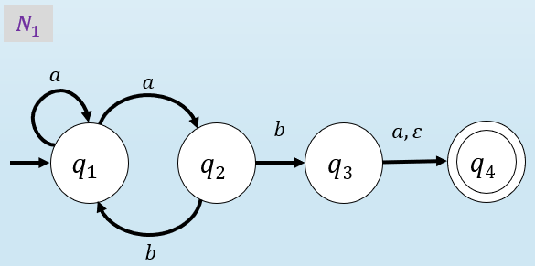
Nondeterministic Finite Automata (NFA)
Def: A nondeterministic finite automaton 𝑁 is a 5-tuple (𝑄𝑄, Z, 𝛿𝛿, 𝑞₀, 𝐹)
A list of 5 components
𝑁 = (𝑄𝑄, Z, 𝛿𝛿, 𝑞₀, 𝐹)
𝑄𝑄: finite set of states
Z: alphabet, finite
𝛿𝛿: transition function
𝑞₀: start state
𝐹: set of ACCEPT states
set symbols
Power Set
𝛿𝛿: 𝑄𝑄 × Z_{𝗌} → 𝘗(𝑄𝑄) = {𝑆|𝑆 ⊆ 𝑄𝑄}
𝐹 ⊆ 𝑄𝑄
Σ ∪ {ε}
In the 𝑁₁ example: 𝛿𝛿 𝑞₁, 𝑎 = {𝑞₁, 𝑞₂}
𝛿𝛿 (𝑞₁, 𝑏) = ∅

Slide 18
Nondeterministic Finite Automata (NFA)
𝑁 = (𝑄𝑄, Z, 𝛿𝛿, 𝑞₀, 𝐹)
𝑄𝑄: finite set of states
Z: alphabet, finite set symbols
Example:
𝑁₁
𝑎
𝑎
𝑏
𝑎, 𝜀𝜀
𝑞₁
𝑞₂
𝑞₃
𝑞₄
𝛿𝛿: 𝑄𝑄 × Z → 𝘗(𝑄𝑄)
𝑏
𝗌
𝑁₁ = (𝑄𝑄, Z, 𝛿𝛿, 𝑞₀, 𝐹)
𝑞₀: start state
𝐹: set of ACCEPT states
𝑄𝑄 = {𝑞₁, 𝑞₂, 𝑞₃, 𝑞₄} Z = {𝑎, 𝑏}
𝛿𝛿 =
 | 𝑎 | 𝑏 | 𝜺
𝒒𝒒₁ | 𝑞₁, 𝑞₂ | ∅ | ∅
𝒒𝒒_{𝟐𝟐} | ∅ | 𝑞₁, 𝑞₃ | ∅
𝒒𝒒_{𝟑𝟑} | 𝑞₄ | ∅ | 𝑞₄
𝒒𝒒_{𝟒𝟒} | ∅ | ∅ | ∅
𝑞₀ = 𝑞₁
𝐹 = {𝑞₄}

Slide 19
Converting NFAs to DFAs
Theorem: If an NFA recognizes 𝐴 then 𝐴 is regular.
Even though NFAs seem to be more powerful than DFAs, in reality, they can recognize the same class of languages, the regular languages.
Proof: by Construction
Construct a DFA from an NFA
Let NFA 𝑁 = (𝑄𝑄, Z, 𝛿𝛿, 𝑞₀ , 𝐹) recognize 𝐴
Construct a DFA 𝑀 = (𝑄𝑄 ′ , Z, 𝛿𝛿′, 𝑞′₀, 𝐹′) recognizing 𝐴
(Ignore the 𝜀𝜀-transitions, can easily modify to handle them)
IDEA: DFA 𝑀 keeps track of the subset of possible states in NFA 𝑁.

Slide 20
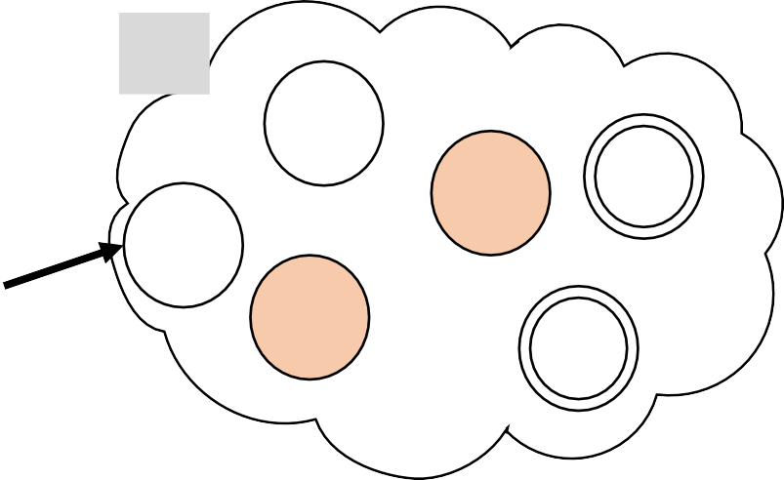
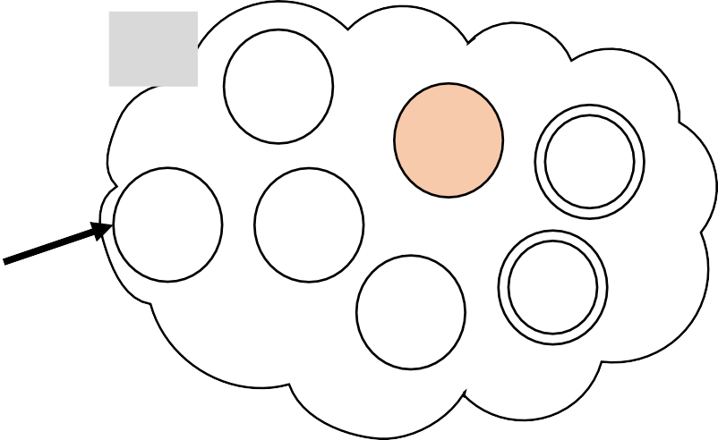
Converting NFAs to DFAs
Theorem: If an NFA recognizes 𝐴 then 𝐴 is regular. Proof: by Construction
Let NFA 𝑁 = (𝑄𝑄, Z, 𝛿𝛿, 𝑞₀ , 𝐹) recognize 𝐴
Construct a DFA 𝑀 = (𝑄𝑄 ′ , Z, 𝛿𝛿′, 𝑞′₀, 𝐹′) recognizing 𝐴
(Ignore the 𝜀𝜀-transitions, can easily modify to handle them)
IDEA: DFA 𝑀 keeps track of the subset of possible states in NFA 𝑁.
𝑁
𝑀
{𝑞₃, 𝑞₇}
𝑞₇
𝑞₃

Slide 21
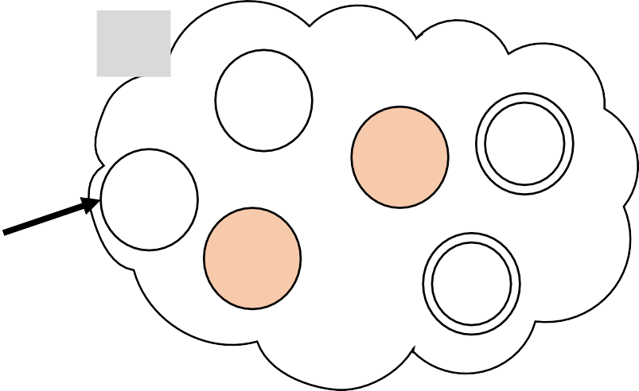

Converting NFAs to DFAs
Theorem: If an NFA recognizes 𝐴 then 𝐴 is regular. Proof: by Construction
Let NFA 𝑁 = (𝑄𝑄, Z, 𝛿𝛿, 𝑞₀ , 𝐹) recognize 𝐴
Construct a DFA 𝑀 = (𝑄𝑄 ′ , Z, 𝛿𝛿′, 𝑞′₀, 𝐹′) recognizing 𝐴
(Ignore the 𝜀𝜀-transitions, can easily modify to handle them)
IDEA: DFA 𝑀 keeps track of the subset of possible states in NFA 𝑁.
𝑁
𝑀
The DFA 𝑀 is going to have a state for every possible subset of states of the NFA 𝑁
{𝑞₃, 𝑞₇}
𝑞₇
𝑞₃

Slide 22
Converting NFAs to DFAs
Theorem: If an NFA recognizes 𝐴 then 𝐴 is regular. Proof: by Construction
Let NFA 𝑁 = (𝑄𝑄, Z, 𝛿𝛿, 𝑞₀ , 𝐹) recognize 𝐴
Construct a DFA 𝑀 = (𝑄𝑄 ′ , Z, 𝛿𝛿′, 𝑞′₀, 𝐹′) recognizing 𝐴
(Ignore the 𝜀𝜀-transitions, can easily modify to handle them)
Components of 𝑀:
𝑄𝑄′ = 𝘗 𝑄𝑄
The states of 𝑀 is the powerset of 𝑁 states.
The set of subsets of states from 𝑀
_{𝛿𝛿}′
𝑅, 𝑎 = 𝑞 𝑞 ∈ 𝛿𝛿(𝑟, 𝑎) for some 𝑟 ∈ 𝑅}
The transitions of 𝑀 is all the possible transitions that 𝑁 could take.
𝑅 ∈ 𝑄𝑄′
_{𝑞}′
= {𝑞₀}
0
𝐹′ = 𝑅 ∈ 𝑄𝑄′
𝑅 intersects 𝐹}
All the subsets that have at least one accepting state in 𝑁.

Slide 23


Converting NFAs to DFAs
Theorem: If an NFA recognizes 𝐴 then 𝐴 is regular.
Proof: by Construction
Let NFA 𝑁 = (𝑄𝑄, Z, 𝛿𝛿, 𝑞₀ , 𝐹) recognize 𝐴
Construct a DFA 𝑀 = (𝑄𝑄 ′ , Z, 𝛿𝛿′, 𝑞′₀, 𝐹′) recognizing 𝐴
(Ignore the 𝜀𝜀-transitions, can easily modify to handle them)
Components of 𝑀:
𝑄𝑄′ = ℙ 𝑄𝑄 The states of 𝑀 is the powerset of 𝑁 states.
𝛿𝛿′ 𝑅, 𝑎 = 𝑞 𝑞 ∈ 𝛿𝛿(𝑟, 𝑎) for some 𝑟 ∈ 𝑅} The transitions of 𝑀 is all the possible transitions
_{𝑅 ∈ 𝑄𝑄′} that 𝑁 could take.
′
𝑞₀ = {𝑞₀}
𝐹′ = 𝑅 ∈ 𝑄𝑄′ 𝑅 intersects 𝐹} All the subsets that have at least one accepting state in 𝑁.
Question:
If 𝑁 has 𝑛 states, how many states does 𝑀 have by this construction?
2𝑛
𝑛²
2^{𝑛𝑛}
𝑄𝑄′ = 𝘗 𝑄𝑄
The number of subsets is going to be exponential (in the worst case)

Slide 24

Returning to Closure Properties…
Theorem: If 𝐴₁, 𝐴₂ are regular languages, so is 𝐴₁ ∪ 𝐴₂ (closure under ∪)
Proof: by Construction (using DFAs)
Let 𝑀₁ = (𝑄𝑄₁, Z, 𝛿𝛿₁ , 𝑞₁ , 𝐹₁ ) recognize 𝐴₁
𝑀₂ = (𝑄𝑄₂, Z, 𝛿𝛿₂ , 𝑞₂ , 𝐹₂ ) recognize 𝐴₂
𝑀₁
𝑀₂
𝑎
𝑏
𝑎
𝑎, 𝑏
𝑡₀
𝑡₁
𝑟₀
𝑟₁
Construct 𝑀 = (𝑄𝑄 , Z, 𝛿𝛿 , 𝑞 , 𝐹)
𝑎, 𝑏
𝑏
0
recognizing 𝐴₁ ∪ 𝐴₂
𝑀
𝑡₀ , 𝑟₀
𝑎, 𝑏
𝑡₁ , 𝑟₀
𝑀 should accept input 𝑤 if either 𝑀₁ or 𝑀₂
accept 𝑤.
The possibilities we have to keep track in 𝑀
are all the pair of states of 𝑀₁ and 𝑀₂
𝑏
𝑏
𝑏
𝑎
𝑎
𝑡 , 𝑟
𝑡₀ , 𝑟₁
1 1
𝑎

Slide 25
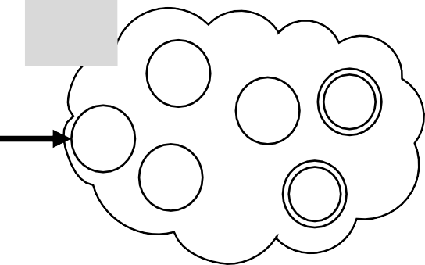
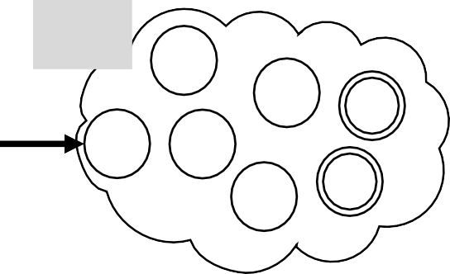
Closure Properties – Union (NFA)
Theorem: If 𝐴₁, 𝐴₂ are regular languages, so is 𝐴₁ ∪ 𝐴₂ (closure under ∪)
New Proof (sketch): by Construction
Using Nondeterminism
Given DFAs 𝑀₁ and 𝑀₂ that recognize 𝐴₁ and 𝐴₂
Construct NFA 𝑁 recognizing 𝐴₁ ∪ 𝐴₂
𝑀₁
𝑀₂

Slide 26
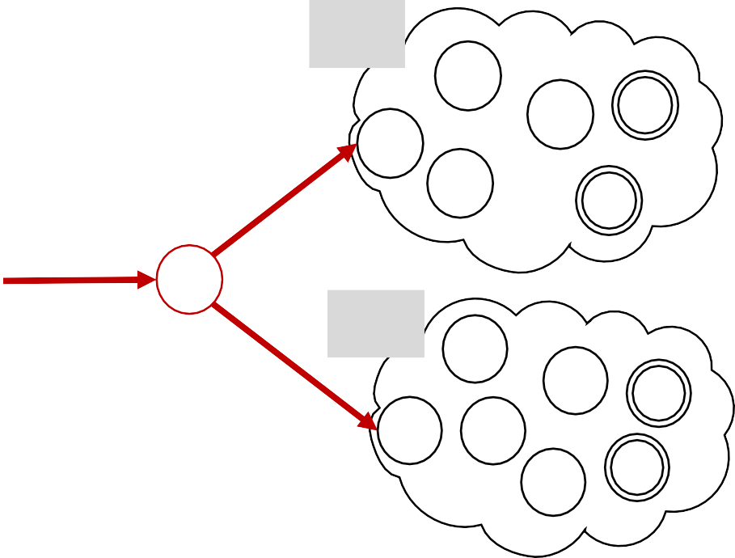
Closure Properties – Union (NFA)
Theorem: If 𝐴₁, 𝐴₂ are regular languages, so is 𝐴₁ ∪ 𝐴₂ (closure under ∪)
New Proof (sketch): by Construction
Using Nondeterminism
Given DFAs 𝑀₁ and 𝑀₂ that recognize 𝐴₁ and 𝐴₂
Construct NFA 𝑁 recognizing 𝐴₁ ∪ 𝐴₂
𝑀₁
𝑁 will branch to 𝑀₁ and 𝑀₂
nondeterministically, as two possibilities
Inside 𝑀₁ and 𝑀₂ it is going to start reading the input and each DFA will follow the transitions in “parallel”
𝑁 as a combination of 𝑀₁ and 𝑀₂ accepts the input if either 𝑀₁ and 𝑀₂ ends in an accept state.
𝑁
𝜀𝜀
𝑀₂
𝜀𝜀

Slide 27
Closure Properties – Union (NFA)
Theorem: If 𝐴₁, 𝐴₂ are regular languages, so is 𝐴₁ ∪ 𝐴₂ (closure under ∪)
𝑀₁
𝑀₂
𝑎
𝑏
𝑎
𝑎, 𝑏
𝑡₀
𝑡₁
𝑟₀
𝑟₁
𝑎, 𝑏
𝑏
𝑏
𝑎
𝑀
𝑁
𝑡₀ , 𝑟₀
𝑎, 𝑏
𝑡₁ , 𝑟₀
𝜀𝜀
𝑡₀
𝑡₁
DFA
NFA
𝑏
𝑏
𝑎, 𝑏
𝑏
𝑛₀
𝑎
𝑎, 𝑏
𝑎
𝜀𝜀
𝑡 , 𝑟
𝑎
𝑡₁ , 𝑟₁
0 1
𝑟₀
𝑟₁
𝑎
𝑏

Slide 28
Closure Properties – Concatenation (previous attempt)
Theorem: If 𝐴₁, 𝐴₂ are regular languages, so is 𝐴₁𝐴₂ (closure under ∘) Proof: by Construction
Let 𝑀₁ = (𝑄𝑄₁, Z, 𝛿𝛿₁ , 𝑞₁ , 𝐹₁ ) recognize 𝐴₁
𝑀₂ = (𝑄𝑄₂, Z, 𝛿𝛿₂ , 𝑞₂ , 𝐹₂ ) recognize 𝐴₂
Construct 𝑀 = (𝑄𝑄 , Z, 𝛿𝛿 , 𝑞₀, 𝐹) recognizing 𝐴₁𝐴₂
Tentative
𝑀₁
𝑎
𝑀
𝑡₁
𝑀₁
𝑎
𝑀₂
𝑡₀
𝑡
1
𝑎
𝑔₁
𝑏
𝑡₂
𝑡₀
𝑔₀
𝑏
𝑡₂
𝑏
𝑔₂
𝑀₂
𝑎
𝑔₁
𝑀 should accept input 𝑤 if 𝑤 = 𝑥𝑦 where
𝑔₀
𝑀₁ accepts 𝑥 and 𝑀₂ accepts 𝑦.
𝑔₂
𝑤
Doesn’t work: Where to split 𝑤?
𝑏
𝑥 𝑦

Slide 29


Closure Properties – Concatenation (NFA)
Theorem: If 𝐴₁, 𝐴₂ are regular languages, so is 𝐴₁𝐴₂ (closure under ∘)
Proof (sketch): by Construction
Using Nondeterminism
Given DFAs 𝑀₁ and 𝑀₂ that recognize 𝐴₁ and 𝐴₂
Construct NFA 𝑁 recognizing 𝐴₁ ∘ 𝐴₂
𝑀₁
𝑀₂

Slide 30
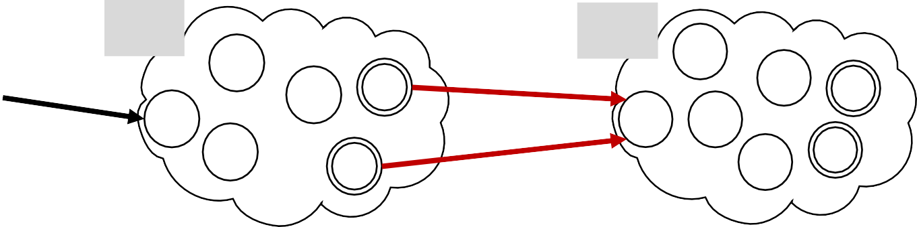
Closure Properties – Concatenation (NFA)
Theorem: If 𝐴₁, 𝐴₂ are regular languages, so is 𝐴₁𝐴₂ (closure under ∘)
Proof (sketch): by Construction
Using Nondeterminism
Given DFAs 𝑀₁ and 𝑀₂ that recognize 𝐴₁ and 𝐴₂
Construct NFA 𝑁 recognizing 𝐴₁ ∘ 𝐴₂
𝑁
𝑀₁
𝑀₂
𝜀𝜀
𝜀𝜀

Slide 31
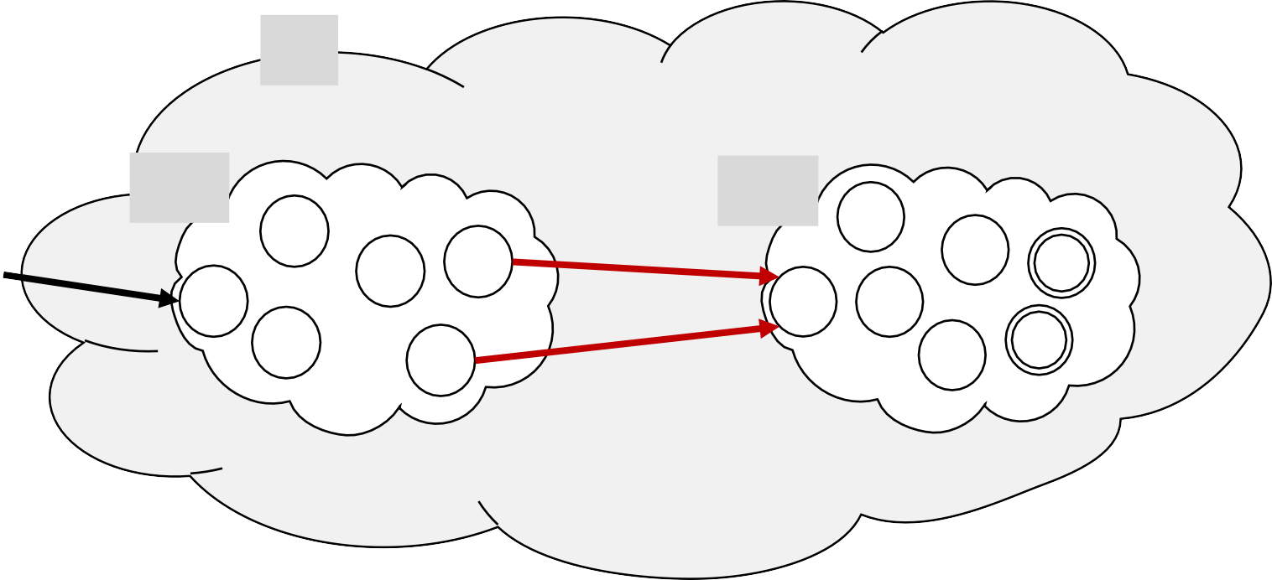
Closure Properties – Concatenation (NFA)
Theorem: If 𝐴₁, 𝐴₂ are regular languages, so is 𝐴₁𝐴₂ (closure under ∘)
Proof (sketch): by Construction
Using Nondeterminism
Given DFAs 𝑀₁ and 𝑀₂ that recognize 𝐴₁ and 𝐴₂
Construct NFA 𝑁 recognizing 𝐴₁ ∘ 𝐴₂
𝑁
Nondeterministic 𝑁 has the option to jump to
𝑀₂ when 𝑀₁ accepts.
𝑀₁
𝑀₂
𝜀𝜀
𝜀𝜀

Slide 32
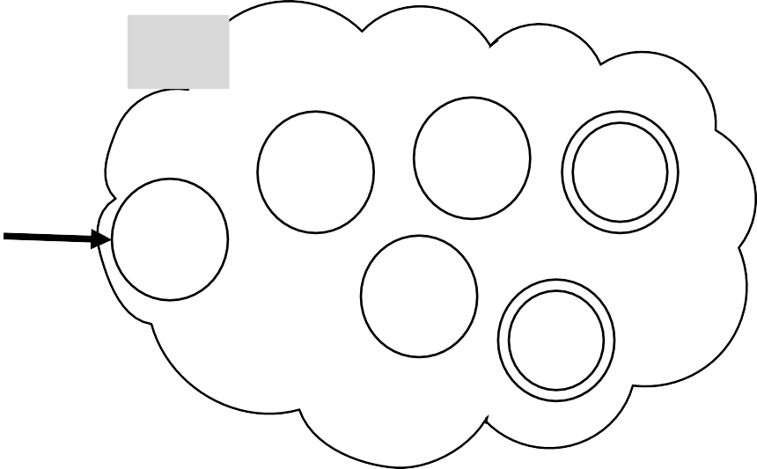
Closure Properties – Star (NFA)
Theorem: If 𝐴 is regular a language, so is 𝐴∗
Proof (sketch): by Construction
Given DFA 𝑀 that recognizes 𝐴
Construct NFA 𝑁 recognizing 𝐴∗
(closure under ∗)
𝑁 should accept input 𝑤 if
𝑀
𝑤 = 𝑥₁𝑥₂ … 𝑥_{𝑘} where 𝑘 ≥ 0
and 𝑀 accepts each 𝑥_{𝑖}
𝑤 =
𝑥₁ 𝑥₂
𝑥₃
𝑥₄

Slide 33
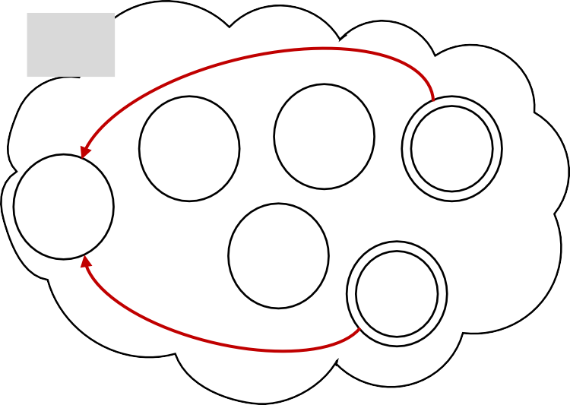
Closure Properties – Star (NFA)
Theorem: If 𝐴 is regular a language, so is 𝐴∗
Proof (sketch): by Construction
Given DFA 𝑀 that recognizes 𝐴
Construct NFA 𝑁 recognizing 𝐴∗
(closure under ∗)
𝑁
𝑁 should accept input 𝑤 if
𝑀
𝜀𝜀
𝑤 = 𝑥₁𝑥₂ … 𝑥_{𝑘} where 𝑘 ≥ 0
and 𝑀 accepts each 𝑥_{𝑖}
𝜀𝜀
𝑤 =
𝑥₁ 𝑥₂
𝑥₃
𝑥₄
𝜀𝜀

Slide 34
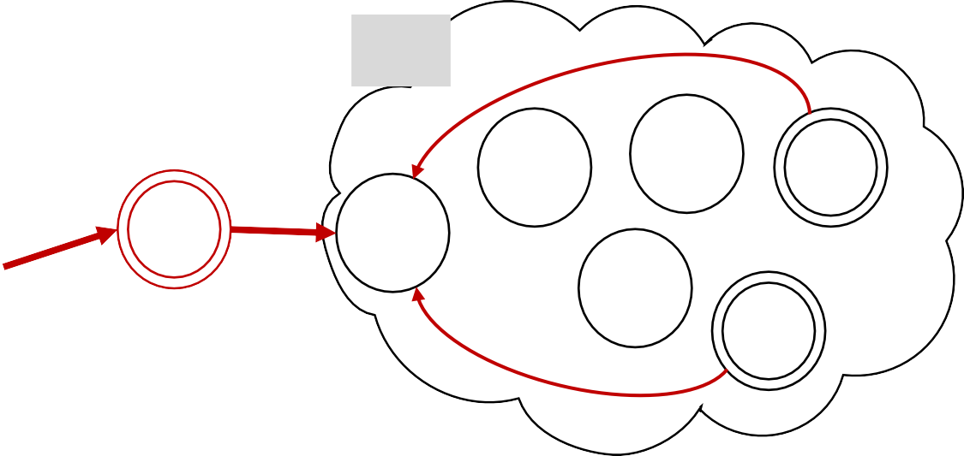


Closure Properties – Star (NFA)
Theorem: If 𝐴 is regular a language, so is 𝐴∗
Proof (sketch): by Construction
Given DFA 𝑀 that recognizes 𝐴
Construct NFA 𝑁 recognizing 𝐴∗
(closure under ∗)
Question
If 𝑀 has 𝑛 states, how many states does 𝑁 have by this construction?
𝑛
𝑛 + 1
2𝑛
𝑁
𝑀
𝜀𝜀
𝜀𝜀
𝜀𝜀
We just added 1 new state in 𝑁

Slide 35
Regular Expressions Equivalence with Finite Automata
Show finite automata equivalent to regular expressions
Convert Regular Expression to Finite Automata
Regular Expression
Finite Automata
Convert Finite Automata to Regular Expression

Slide 36
Regular Expressions Equivalence with Finite Automata
Show finite automata equivalent to regular expressions
Convert Regular Expression to Finite Automata
Regular Expression
Finite Automata

Slide 37
Regular Expressions Equivalence with Finite Automata
Regular Expression
Finite Automata
Theorem: If 𝑅 is a regular expression and 𝐴 = 𝐿 𝑅
then 𝐴 is regular
Proof:
Convert 𝑅 to equivalent NFA 𝑁:
Example:
Convert a ∪ ab ∗ to equivalent NFA
Atomic Elements:
𝑅 = 𝑎 for 𝑎 ∈ Σ
𝑅 = ε
𝑅 = ∅
Composite Elements:
Equivalent 𝑁 is:
𝑎
𝑎
𝑏
𝑎
atomic
𝑏
atomic
}
𝑅 = 𝑅₁ ∪ 𝑅₂
𝑅 = 𝑅₁ ∘ 𝑅₂
Use closure constructions
𝑅 = 𝑅∗
1

Slide 38

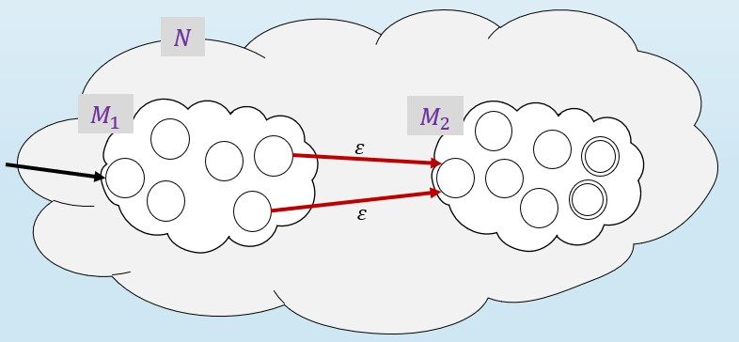
Regular Expressions Equivalence with Finite Automata
Regular Expression
Finite Automata
Theorem: If 𝑅 is a regular expression and 𝐴 = 𝐿 𝑅
then 𝐴 is regular
Proof:
Convert 𝑅 to equivalent NFA 𝑁:
Example:
Convert
𝑎
a ∪ ab ∗ to equivalent NFA
Atomic Elements:
𝑅 = 𝑎 for 𝑎 ∈ Σ
𝑅 = ε
𝑅 = ∅
Composite Elements:
Equivalent 𝑁 is:
𝑎
𝑎
𝑏
atomic
𝑏
atomic
𝑎𝑏
𝑎
ε
𝑏
Concatenation
}
𝑅 = 𝑅₁ ∪ 𝑅₂
𝑅 = 𝑅₁ ∘ 𝑅₂
Use closure constructions
𝑅 = 𝑅∗
1

Slide 39

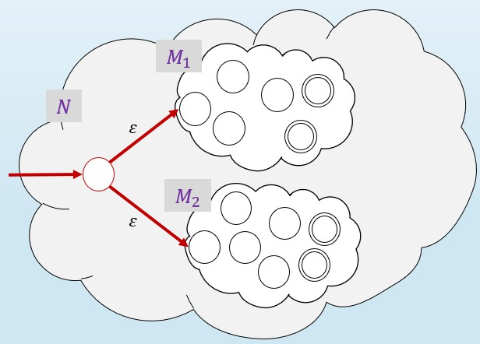
Regular Expressions Equivalence with Finite Automata
Regular Expression
Finite Automata
Theorem: If 𝑅 is a regular expression and 𝐴 = 𝐿 𝑅
then 𝐴 is regular
Proof:
Convert 𝑅 to equivalent NFA 𝑁:
Example:
Convert
𝑎
a ∪ ab ∗ to equivalent NFA
Atomic Elements:
𝑅 = 𝑎 for 𝑎 ∈ Σ
𝑅 = ε
𝑅 = ∅
Composite Elements:
Equivalent 𝑁 is:
𝑎
𝑎
𝑏
𝑏
Union
𝑎
ε
𝑏
𝑎𝑏
𝑎
ε
}
𝑎 ∪ 𝑎𝑏
𝑎
ε
𝑏
𝑅 = 𝑅₁ ∪ 𝑅₂
ε
𝑅 = 𝑅₁ ∘ 𝑅₂
Use closure constructions
𝑅 = 𝑅∗
1

Slide 40

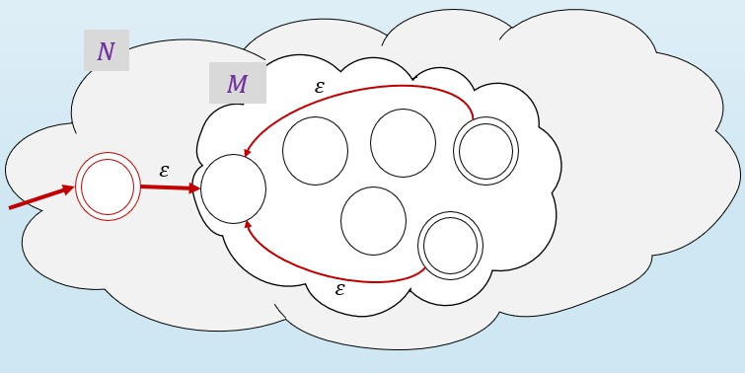
Regular Expressions Equivalence with Finite Automata
Regular Expression
Finite Automata
Theorem: If 𝑅 is a regular expression and 𝐴 = 𝐿 𝑅
then 𝐴 is regular
Proof:
Convert 𝑅 to equivalent NFA 𝑁:
Example:
Convert
𝑎
a ∪ ab ∗ to equivalent NFA
Atomic Elements:
𝑅 = 𝑎 for 𝑎 ∈ Σ
𝑅 = ε
𝑅 = ∅
Composite Elements:
𝑎
𝑏
𝑎
Star
𝑏
𝑎
ε
𝑏
𝑎𝑏
𝑎
ε
}
𝑎 ∪ 𝑎𝑏
𝑎
ε
𝑏
𝑅 = 𝑅₁ ∪ 𝑅₂
ε
ε
𝑎
𝑅 = 𝑅₁ ∘ 𝑅₂
Use closure constructions
ε
ε
𝑎 ∪ 𝑎𝑏
∗
𝑎
ε
𝑏
𝑅 = 𝑅∗
ε
ε
1

Slide 41
Quick review of today
Nondeterministic finite automata (NFA)
Proved: NFA and DFA are equivalent in power
Proved: Class of regular languages is closed under ∘, ∗
Conversion of regular expressions to NFA

Slide 42
Next Class
Equivalence between Finite Automata and Regular Expressions
Textbook Section 1.3 - RegEx

